Slide 1
Enemy Item Identification with Text Similarity
Kirk A. Becker, PhD – Pearson VUE

Slide 2
Text Similarity
The goal of a similarity analysis is to produce a value that indicates whether two text documents have common characteristics.
This could mean that the documents are about the same topic, were written by the same author, deserve the same score, were copied or plagiarized, or should be classified into the same category.
The field of Natural Language Processing offers multiple methods for calculating the similarity between text documents—a paragraph, a test item, a chapter, or any other selection of text
Similarity indices that rely only on specific words (lexical similarity), rather than a representation of the meaning of those words (semantic similarity), are easier to calculate but will potentially be less accurate in identifying relevant references

Slide 3
Text Similarity
Matching – Number of terms in common
Dice – Percentage of all terms that are common
Jaccard – Normalized matching, penalizing for low-overlap
Overlap – Percentage of one document overlapping with the other
Cosine – Angular distance between semantic vectors
Latent Semantic Analysis – Representation of content as a “semantic space” where dimensions represent meaning rather than specific terms

Slide 4
Item Components
Full Text
Stem
Key
Distractors

Slide 5
Text Cleaning
Punctuation
Numbers
Case
Stopwords
Domain specific words/phrases
Special Characters

Slide 6
Stemming/Lemmatization
Stemming is the action of algorithmically converting words to their “stems” thereby reducing different tenses and forms of a word to a common root. Stemming leaves “is” as “is”.
The accuracy of the Porter stemmer, like that of all stemming programs, is less than 100%. For example, the Porter stemmer treats the “er” in “wander” as a suffix, even though it is part of the stem
Lemmatization is the process of grouping together the inflected forms of a word so they can be analysed as a single item, identified by the word's lemma, or dictionary form. Lemmatization converts “is” to “be”.

Slide 7
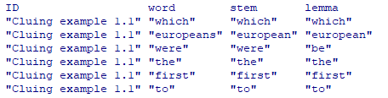
Additional processing
Tokenization - Separating a string (stem, key, distractor) into smaller units (unigrams/words or ngrams/phrases)
Grouping of item content – e.g., all text together, keys separate from stems, etc.
Associating item id with each token

Slide 8
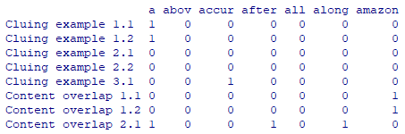
Document/Term Matrix

Slide 9

Cosine Calculation
$\cos{α}=\frac{\overline{a}∙\overline{b}}{\overline{\left\|a\right\|}\overline{\left\|b\right\|}}$

Slide 10
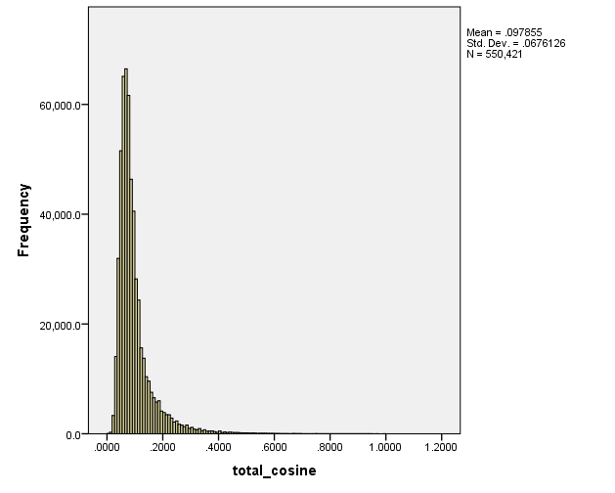
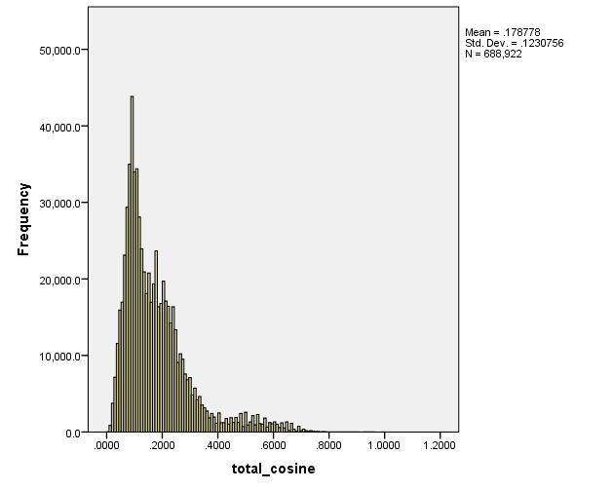
AIG vs. non-AIG item banks (cosine>0)

Slide 11
Summaries When Some Enemies are Known
Cumulative Non-Enemy is a count of the number of item pairs at or above a given range, indicating the number of pairs that would need to be reviewed if that cut were used for item pair selection.
The Cumulative Percent of Enemies is the percentage of currently identified enemies at or above a given cut, which gives us a rough estimate of the percent of all enemies in the pool that would be identified using that cut.
The % of Enemies in Range is the count of (currently identified) enemy pairs divided by the total number of items at a specific range.
Finally, the Cumulative % of Enemies at or Above Range is the cumulative number of enemies divided by the cumulative number of item pairs.

Slide 12
Summaries When Some Enemies are Known

Slide 13
Logistic Regression
Additional characteristics of items may help in identifying enemy relationships
Main content domain
Sub-content domain
Keywords
Combinations of stem, key, distractor cosines

Slide 14
Code Walkthrough
Example item cosine.R
Stem with key cosine.R

Slide 15
Pair Review (Stem+Key=.82)
Which snowmobile manufacturer is based in Thief River Falls, Minnesota?
Key: Arctic Cat
Arctic Cat, located in Thief River Falls, Minnesota, manufactures:
Key: snowmobiles.

Slide 16
Pair Review (Stem+Key=.71)
Which Europeans were the first to establish a colony in the area that is now New York State?
Key: Dutch
Which of the following is Kant's most important contribution to moral philosophy?
Key: The categorical imperative

Slide 17
Pair Review (Key vs. Stem=.71)
A small band of Dakota Indians were rousted by the neighboring Ojibwe after secretly occupying an encampment along the shore of what northwestern Minnesota river?
Key: Thief River
The northern Minnesota river known as Thief River derives its name from:
Key: the Ojibwe phrase “Gimood-akiwi ziibi,” meaning “thieving land river.”

Slide 18
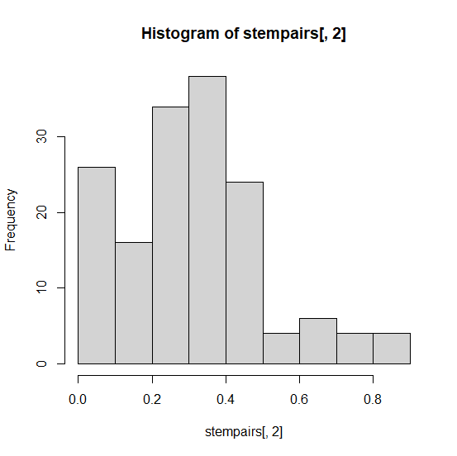
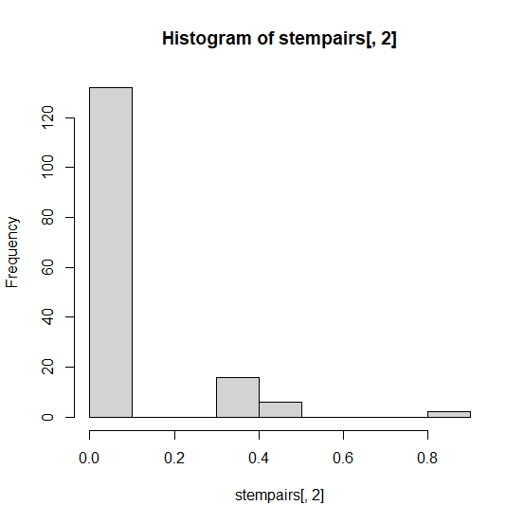
Cosines with and without stopwords removed

Slide 19
Questions?
Kirk.becker@pearson.com

